Slide 1
Multi-fidelity Cost-aware Bayesian Optimization
Sanaz Zanjani Foumani
PhD Student
Mechanical and Aerospace Engineering
University of California, Irvine
zzanjani@uci.edu
Advisor: Dr. Ramin Bostanabad
raminb@uci.edu
USNCCM17, July 2023

Slide 2
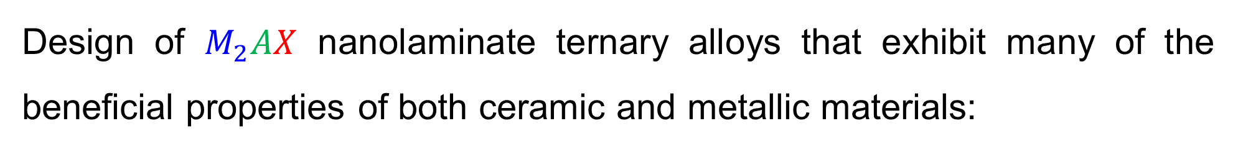
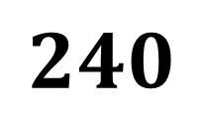
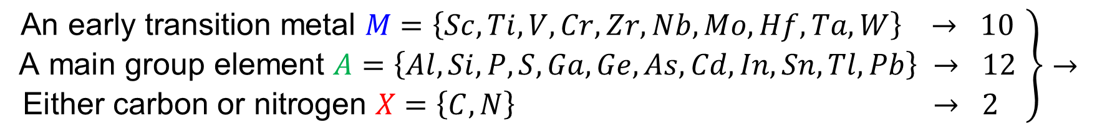
Optimum data collection
Design of $M_{2}AX$ nanolaminate ternary alloys that exhibit many of the beneficial properties of both ceramic and metallic materials:
$$\left.\begin{matrix}\text{An} \text{early} \text{transition} \text{metal} M=\left\{Sc, Ti, V, Cr, Zr, Nb, Mo, Hf, Ta, W\right\} → 10 \\ \text{A} \text{main} \text{group} \text{element} A=\left\{Al, Si, P, S, Ga, Ge, As, Cd, In, Sn, Tl, Pb\right\} → 12 \\ \text{Either} \text{carbon} \text{or} \text{nitrogen} X=\left\{C, N\right\} → 2 \end{matrix}\right\}→$$
$$240$$
Q.1. How can we find the composition with the largest bulk modulus without running 240 expensive DFT simulations?
Q.2. Can we use inaccurate but cheap simulations?
Zhou, Y.C., H.Y. Dong, X.H. Wang, and S.Q. Chen, Electronic structure of the layered ternary carbides ti2snc and ti2gec. Journal of Physics: Condensed Matter, 2000. 12(46): p. 9617.

Slide 3
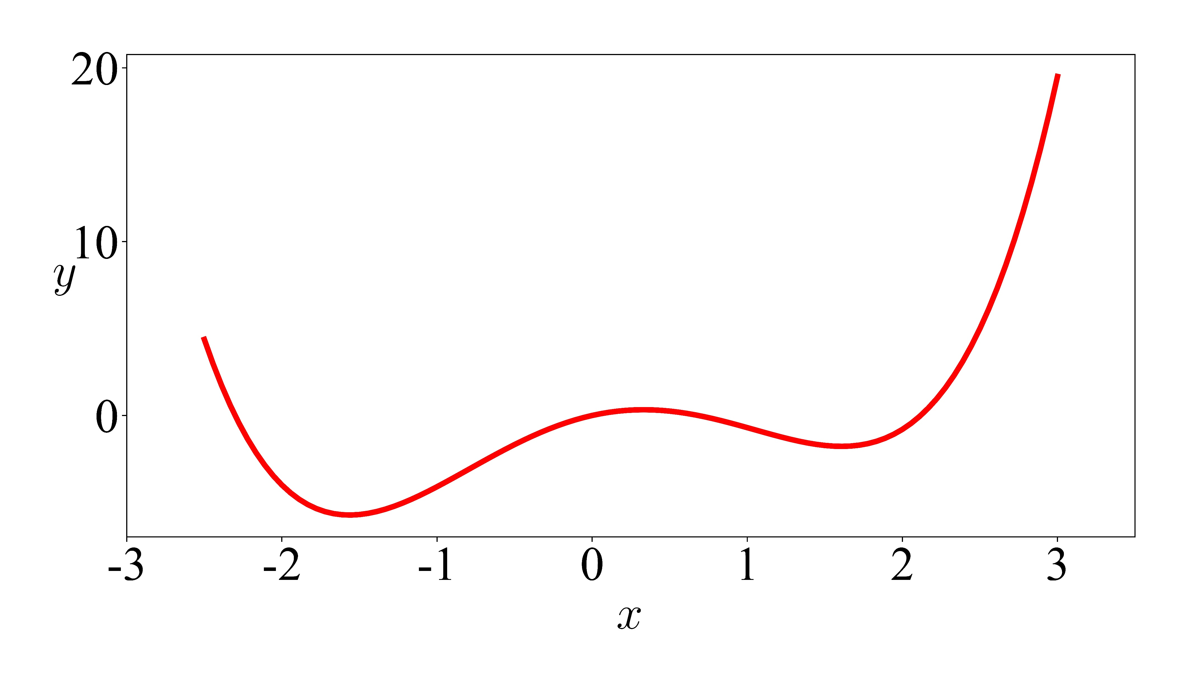
Q.1 Bayesian optimization (BO)
Algorithm for single source BO with continuous data:
Fit an emulator to an initial training data.
Use the emulator in the acquisition function that balances exploration and exploitation to identify the next candidate.
Add the candidate to the data and repeat until convergence.
EXIT
Converged?
Acquisition Function
Collect Data
Yes
No
Mean
Data
Samples
Exploration: High Uncertainty
Initial Data
Emulator
Exploitation:
Better Prediction
Mean
Uncertainty

Slide 4
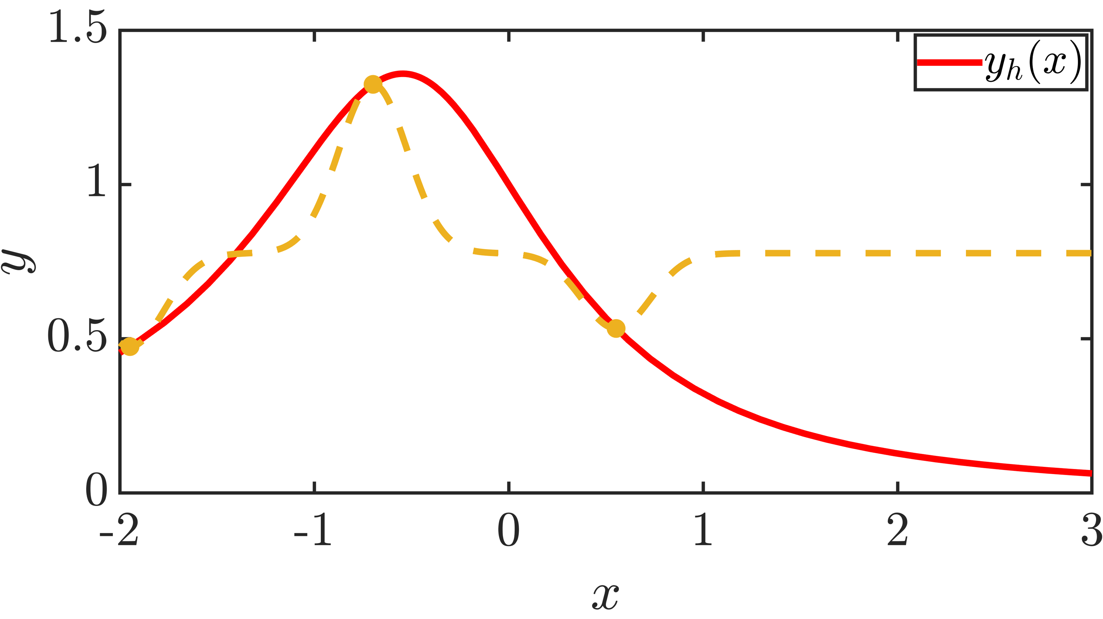
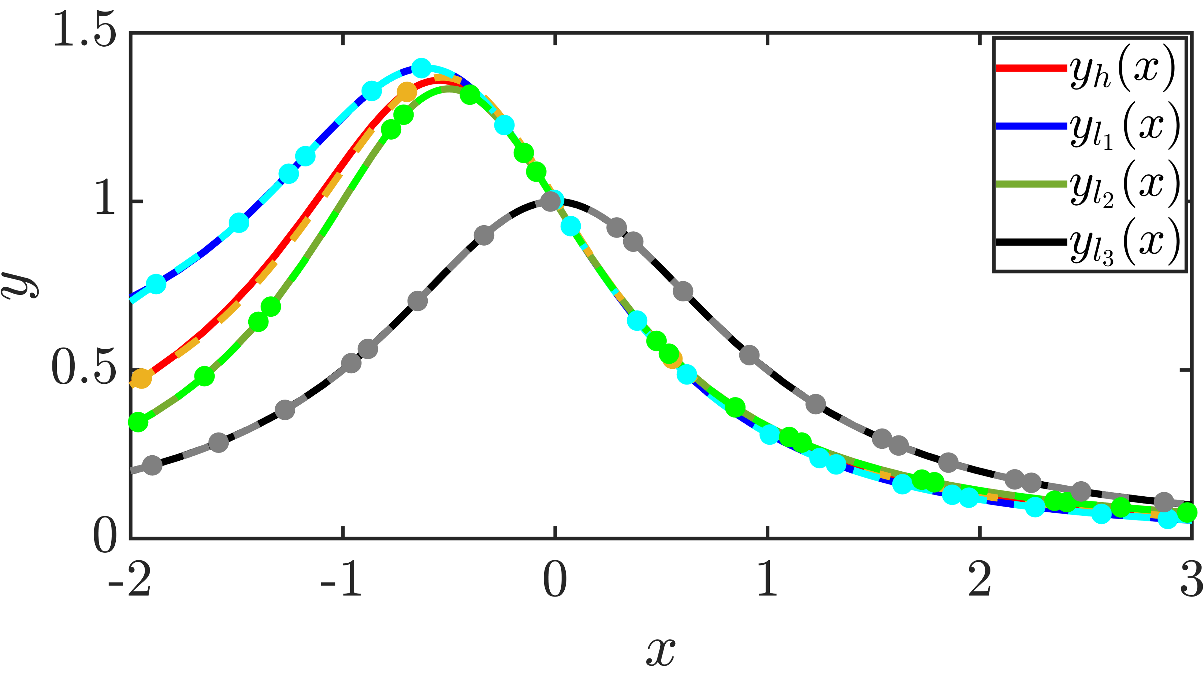
Q.2 Multi-fidelity (MF) setup
Enhancing the accuracy of the high-fidelity emulator estimation by leveraging multiple data sources with varying levels of fidelity:
High-fidelity data are expensive and limited
Low-fidelity data are cheap(er) but have systematic errors
Single-fidelity (SF) Framework
MF Framework
Eweis-Labolle, J.T., N. Oune, and R. Bostanabad, Data Fusion With Latent Map Gaussian Processes. Journal of Mechanical Design, 2022. 144(9).

Slide 5
How Multi-fidelity BO (MFBO) works? (with categorical data)
Zanjani Foumani, Z., et al., Multi-fidelity cost-aware Bayesian optimization. Computer Methods in Applied Mechanics and Engineering, 2023. 407: p. 115937.

Slide 6
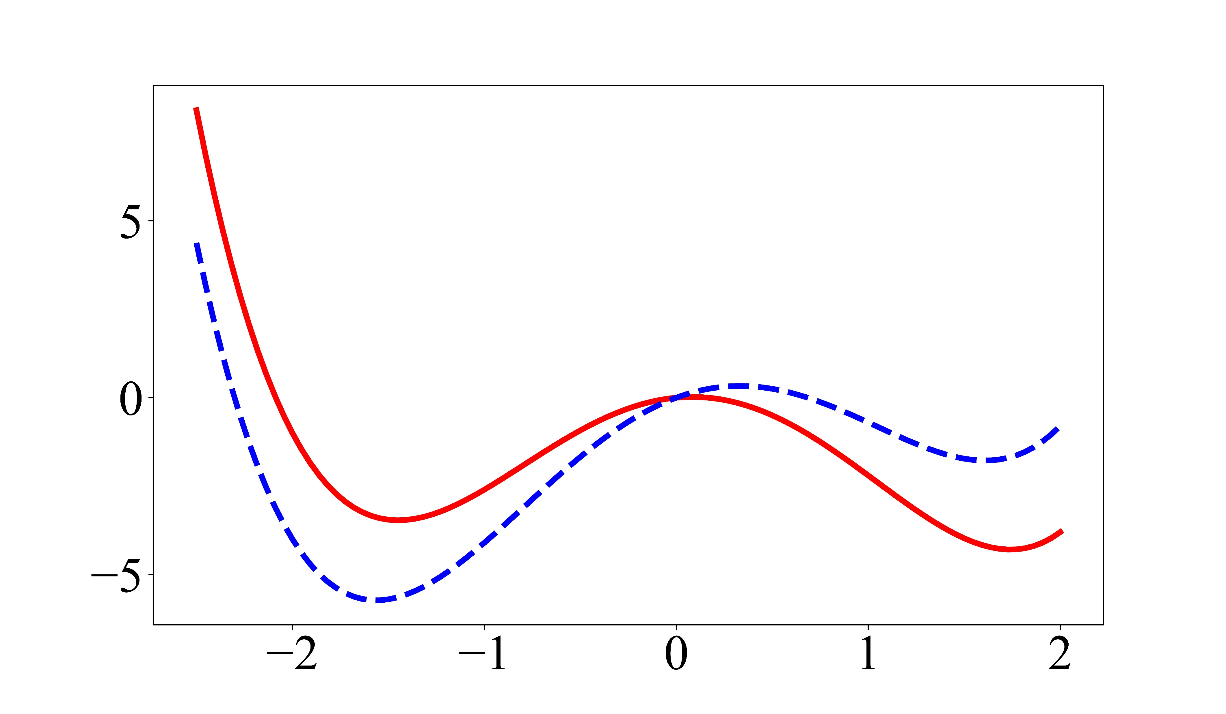
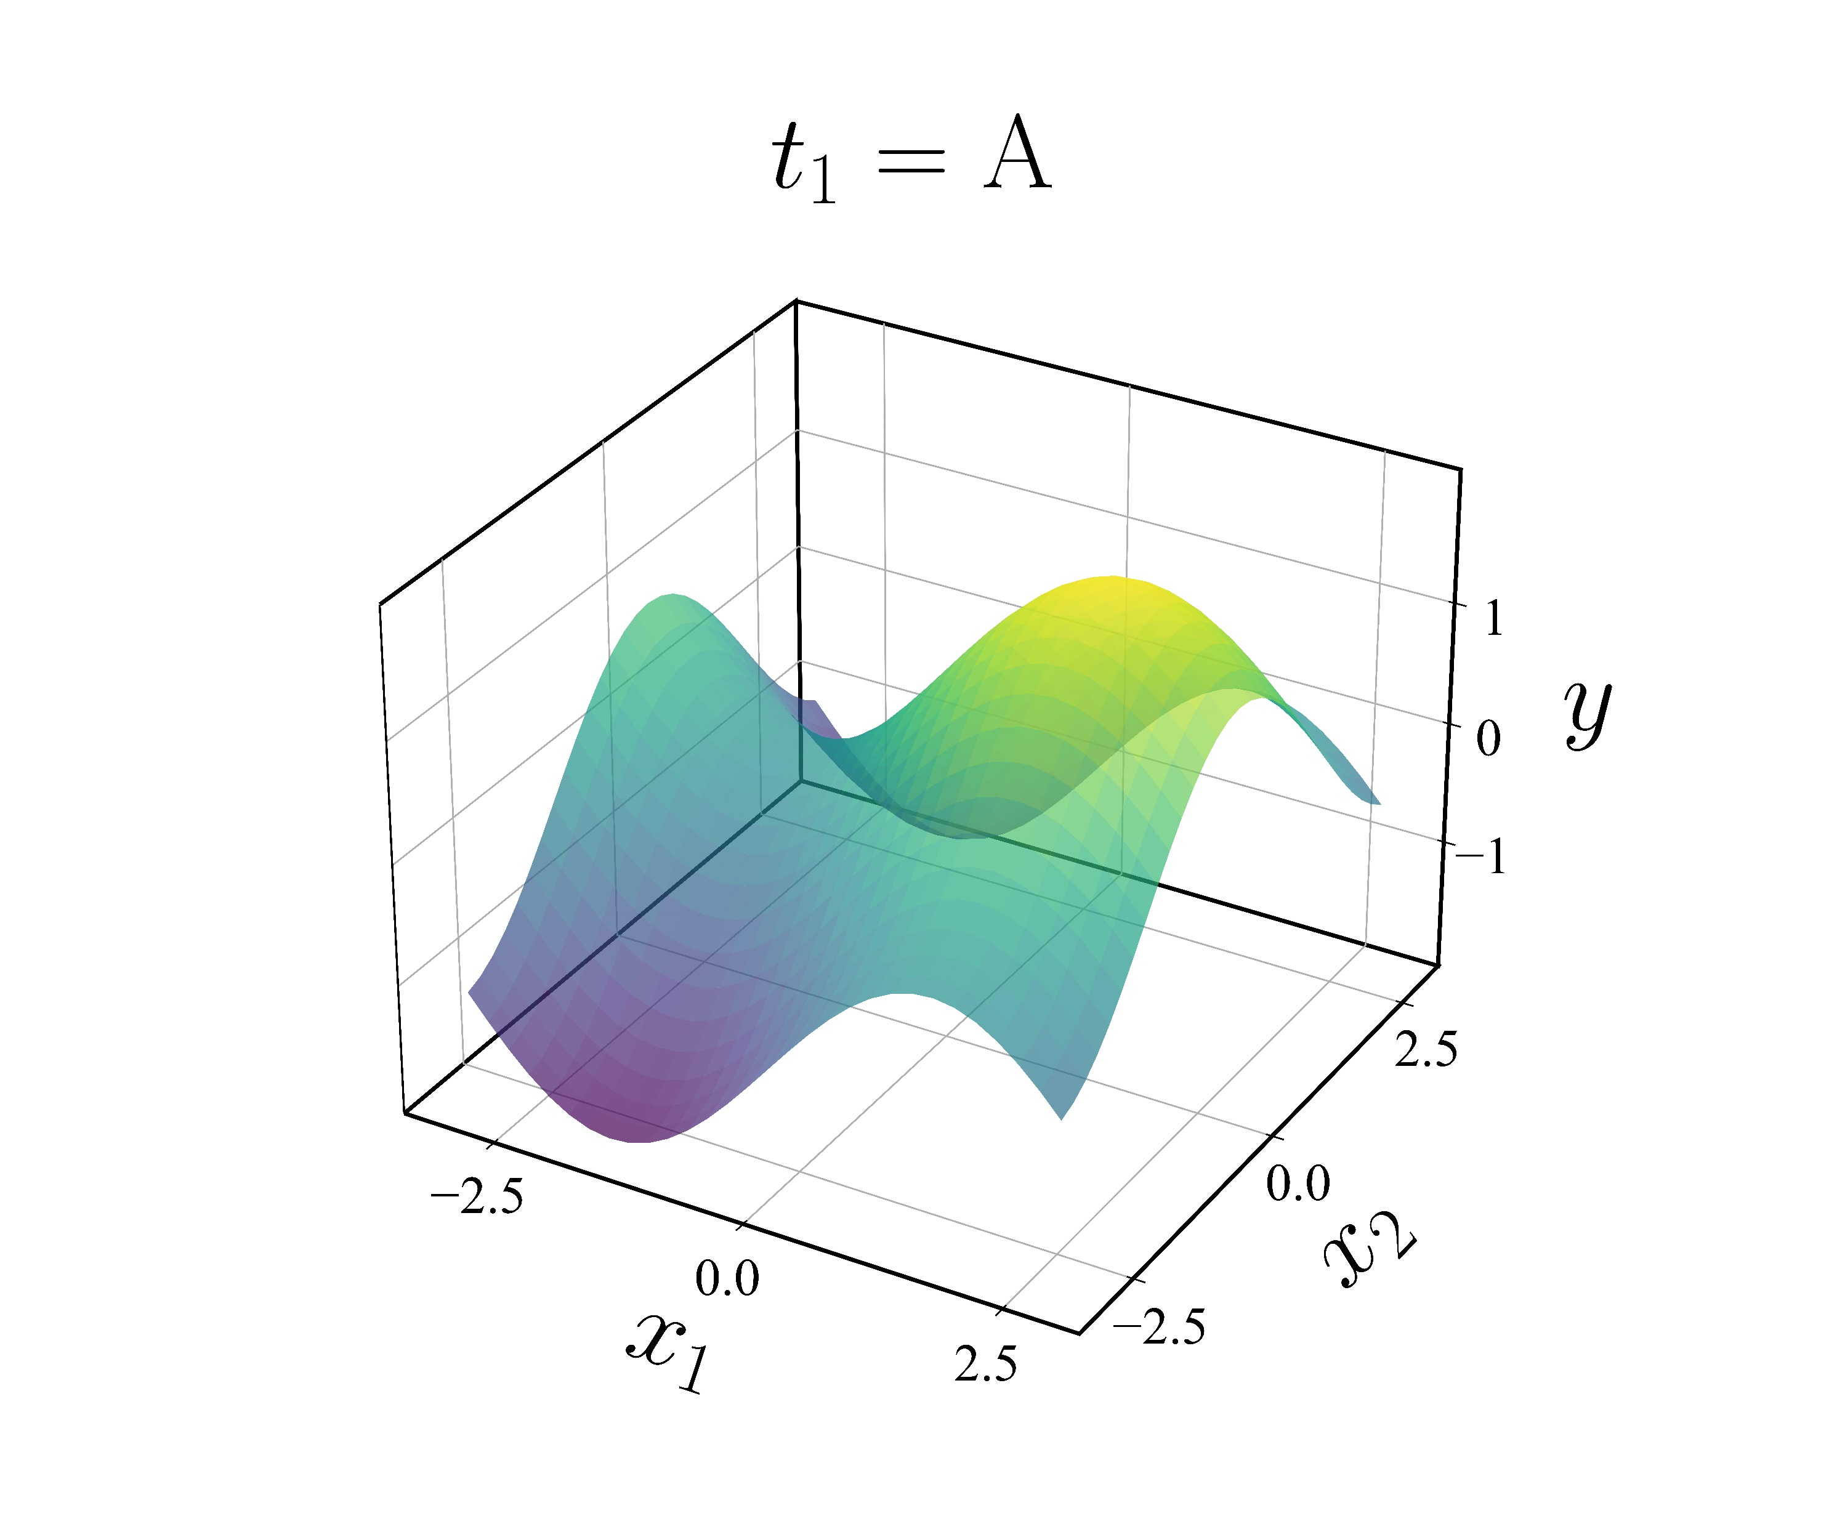
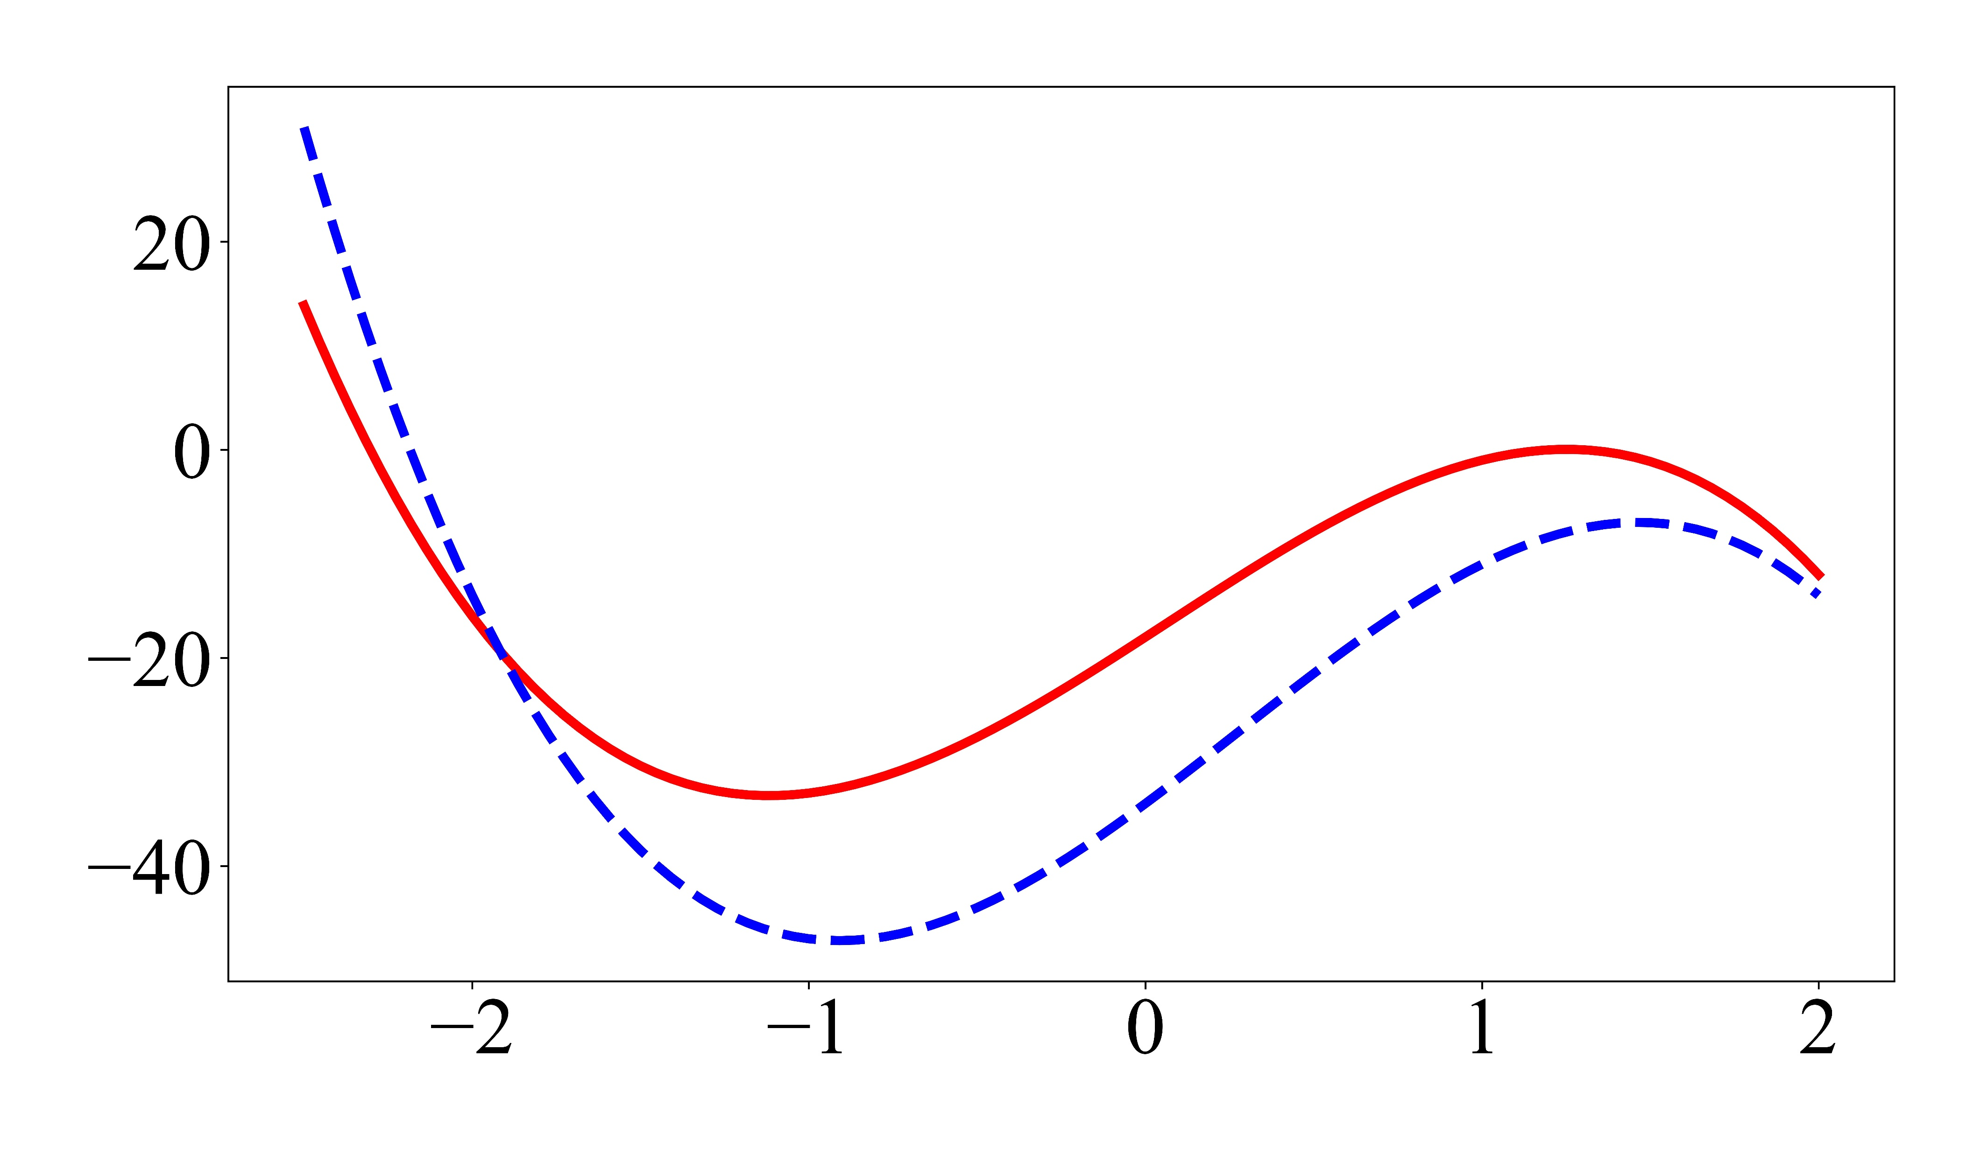
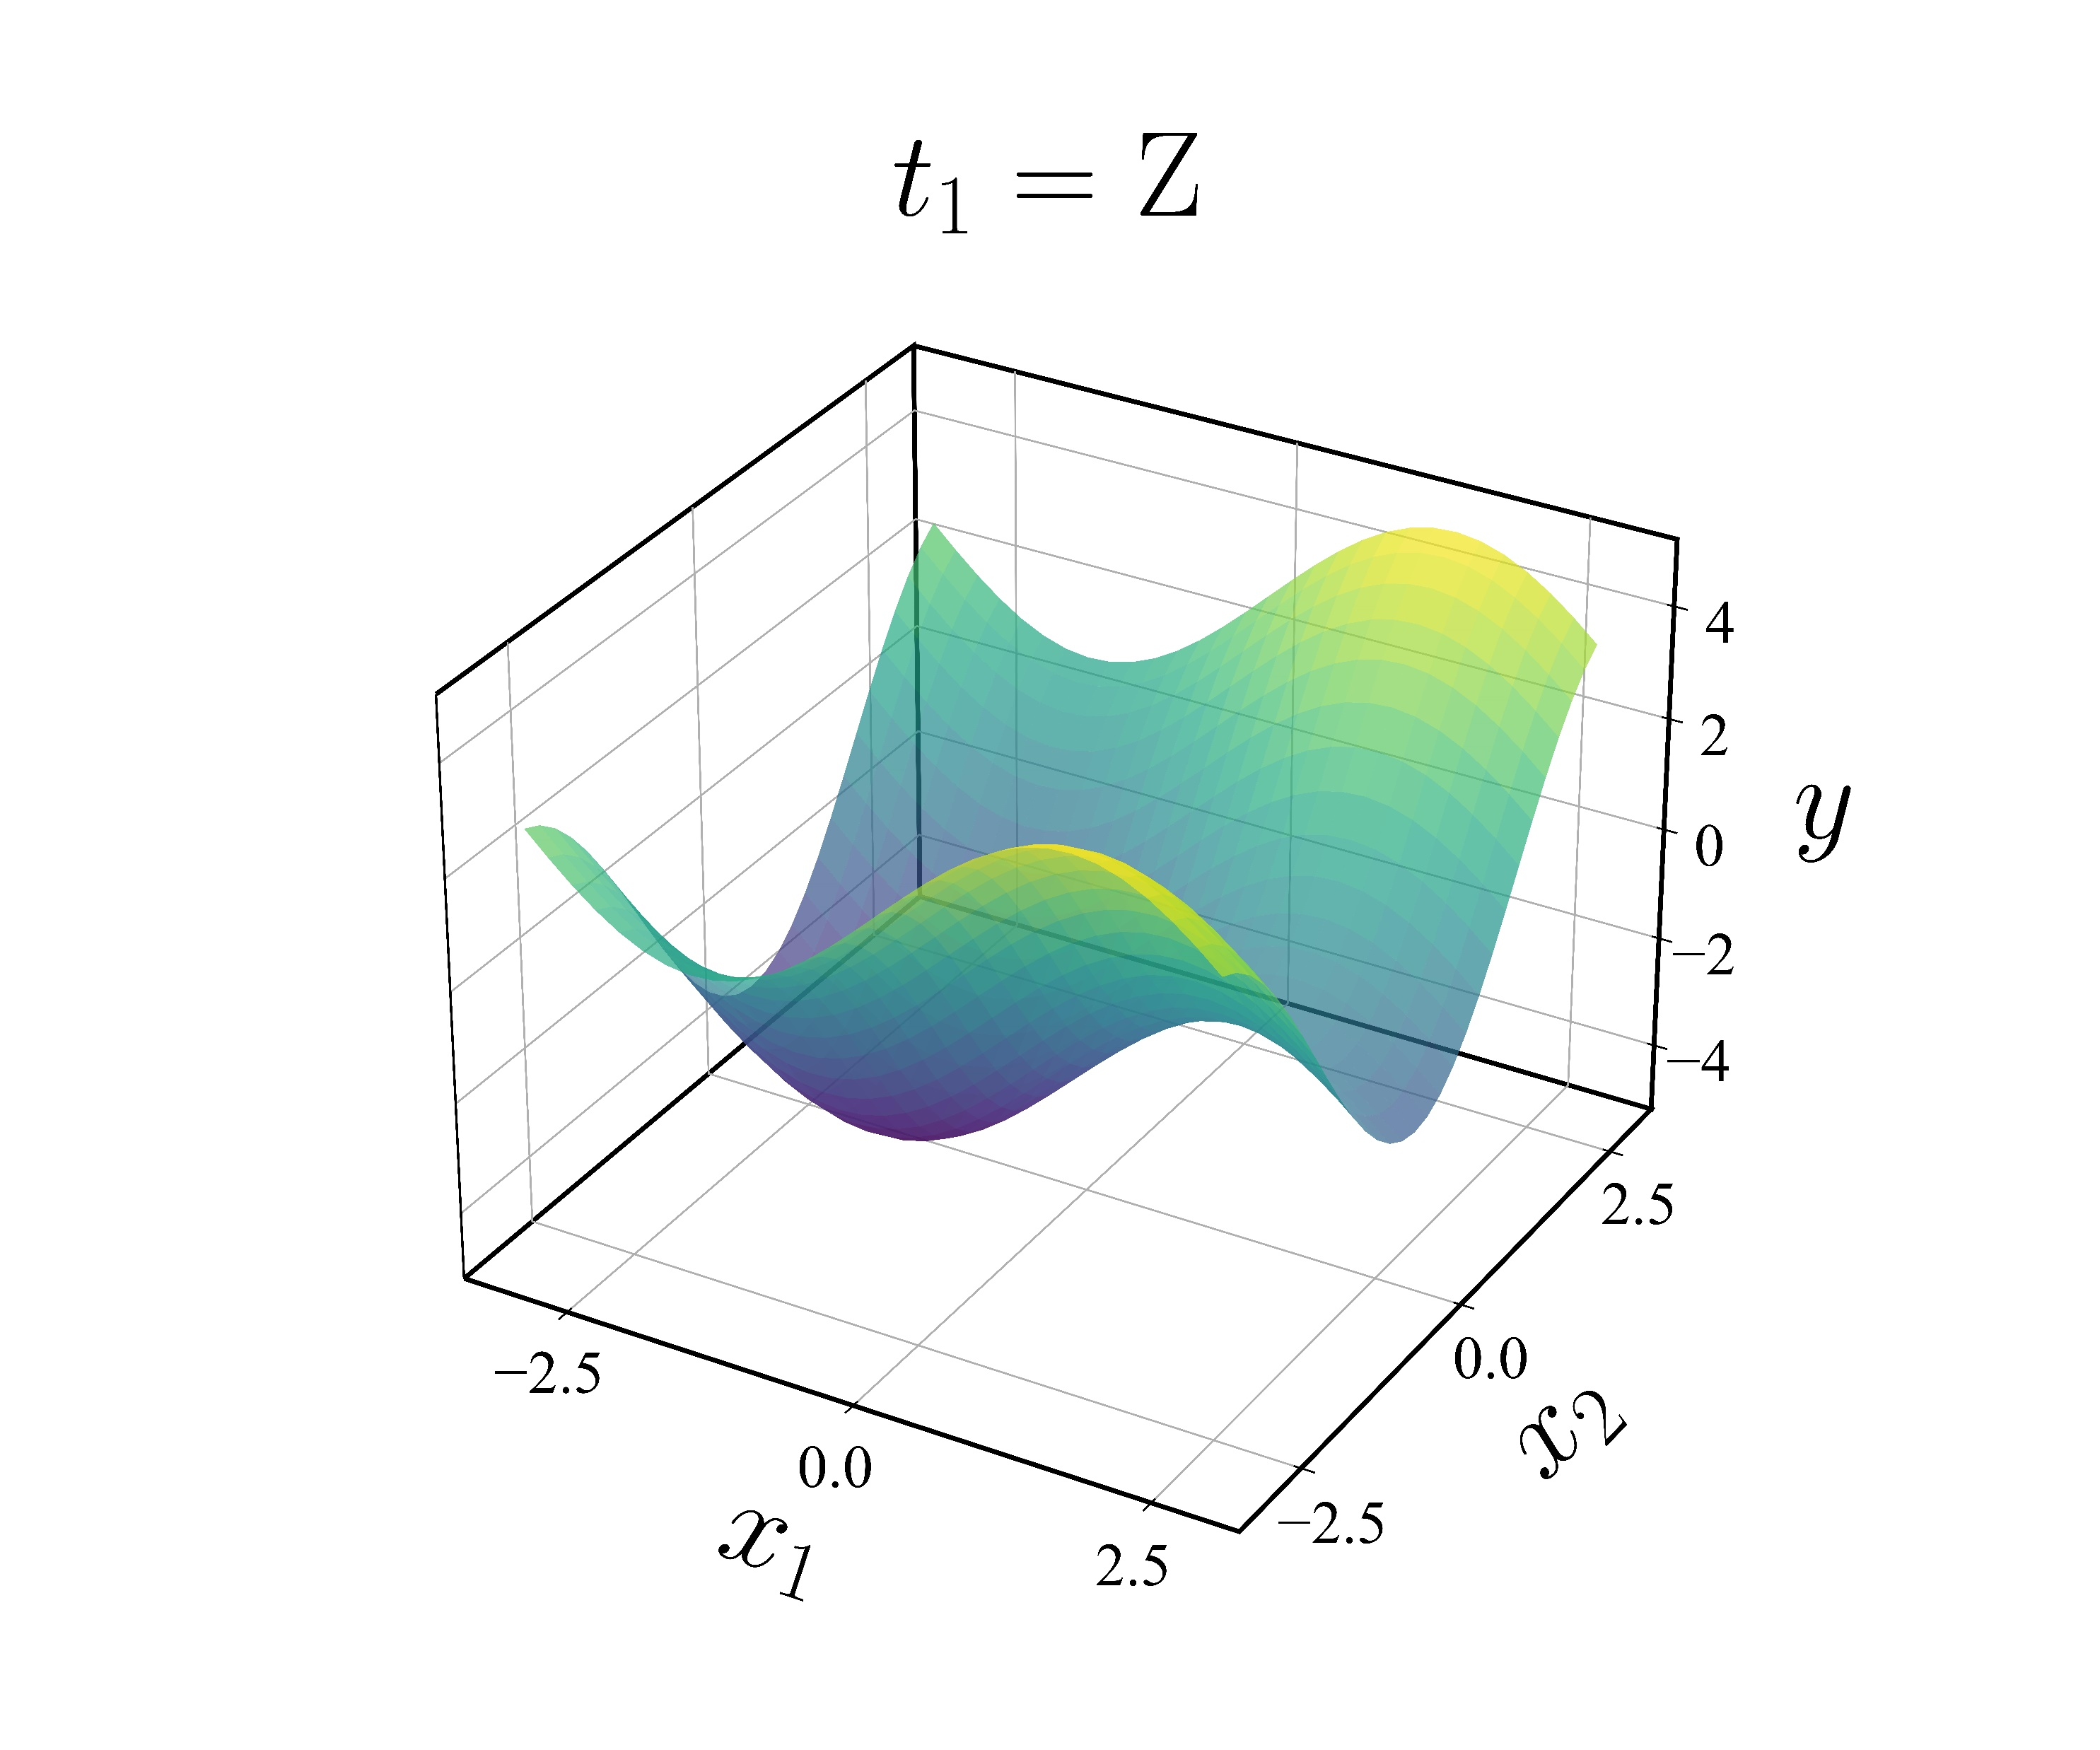
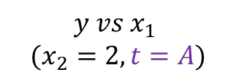
Yes
No
EXIT
Converged?
AF
Collect Data
Emulator
$$y vs x_{1}$$
$$(x_{2}=2, t=A)$$
Mean HF
Mean LF
HF Data
LF Data
,
$$y vs x_{1}$$
$$(x_{2}=2, t=Z)$$
Zanjani Foumani, Z., et al., Multi-fidelity cost-aware Bayesian optimization. Computer Methods in Applied Mechanics and Engineering, 2023. 407: p. 115937.
BO with LF Data

Slide 7
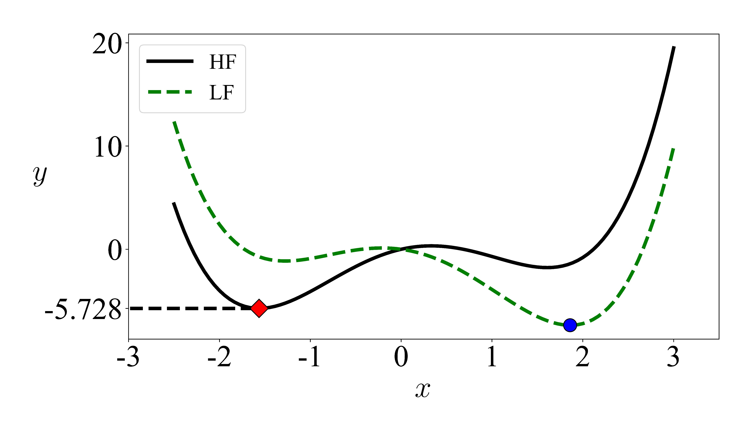
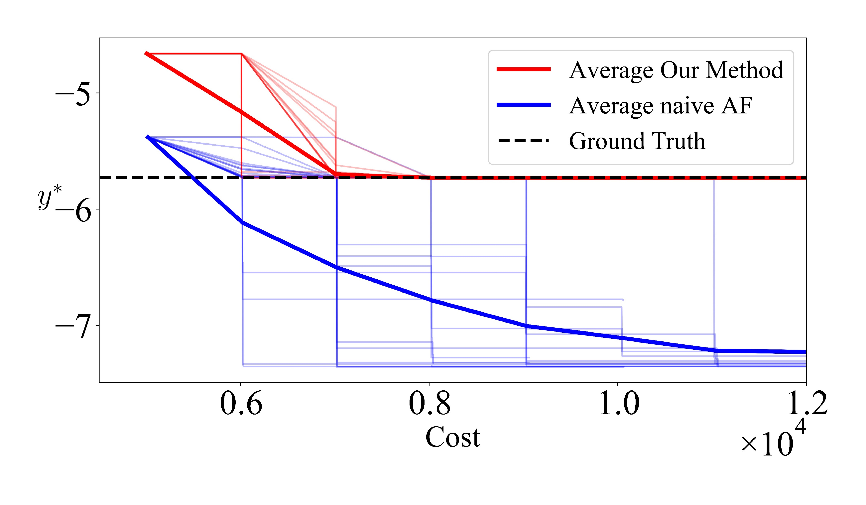
Challenges in mfbo
Multiple coexisting uncertainty sources:
(1) Lack of high-fidelity data (2) Stochastic nature of the data sources
(3) Mixed feature space: Non-differentiable qualitative inputs
(4) Bias of low-fidelity data: Convergence to incorrect optima
Zanjani Foumani, Z., et al., Multi-fidelity cost-aware Bayesian optimization. Computer Methods in Applied Mechanics and Engineering, 2023. 407: p. 115937.

Slide 8
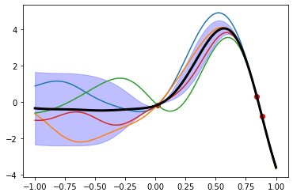
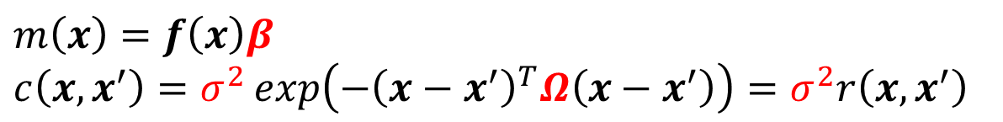
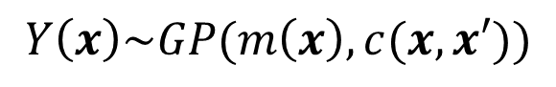
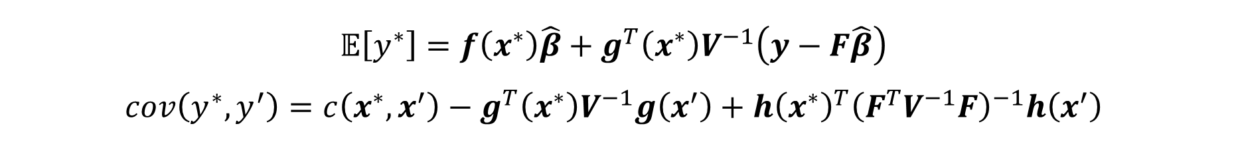
Gaussian processes (GPs)
Completely characterized by mean and covariance functions:
Mean Function
Observation
Realizations
$$Y\left(x\right)\sim GP(m\left(x\right), c(x, x′))$$
Covariance Function
Mean
Parametric forms for mean and covariance functions:
$m\left(x\right)=f\left(x\right)β$
$c\left(x,x^{′}\right)=σ^{2}\exp\left(−{\left(x−x^{′}\right)}^{T}Ω\left(x−x^{′}\right)\right)=σ^{2}r\left(x,x^{′}\right)$
Uncertainty
Prediction upon fitting:
$$𝔼\left[y^{∗}\right]=f\left(x^{∗}\right)\hat{β}+g^{T}\left(x^{∗}\right)V^{−1}\left(y−F\hat{β}\right)$$
$$cov\left(y^{∗},y^{′}\right)=c\left(x^{∗}, x^{′}\right)−g^{T}\left(x^{∗}\right)V^{−1}g\left(x^{′}\right)+{h\left(x^{∗}\right)}^{T}{\left(F^{T}V^{−1}F\right)}^{−1}h\left(x^{′}\right)$$
Planas, R., N. Oune, and R. Bostanabad, Evolutionary Gaussian Processes. Journal of the Mechanical Design, 2021.

Slide 9
GPs: The good, The bad, the ugly
Advantages: Uncertainty quantification, interpretable, fast, robust to overfitting and noise, …
Disadvantages: Scalability, non-Gaussian uncertainties, reversion to the mean, handling categorical/qualitative inputs, …
Why focus on this issue?
Planas, R., N. Oune, and R. Bostanabad, Evolutionary Gaussian Processes. Journal of the Mechanical Design, 2021.
Bostanabad, R., et al. "Leveraging the Nugget Parameter for Efficient Gaussian Process Modeling." International Journal for Numerical Methods in Engineering 114.5 (2018): 501-16. Print.
Bostanabad, R., Y.C. Chan, L.W. Wang, P. Zhu, and W. Chen, Globally approximate gaussian processes for big data with application to data-driven metamaterials design. Journal of Mechanical Design, 2019. 141(11).
Zhang, Yichi, Siyu Tao, Wei Chen, and Daniel W. Apley. "A Latent Variable Approach to Gaussian Process Modeling with Qualitative and Quantitative Factors.". Technometrics 62, no. 3 (Aug 17 2019): 291-302.

Slide 10
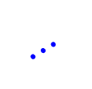











Latent map gaussian process (LMGP)
High Dimensional Prior
Low Dimensional Posterior
$$t_{1}$$
$$t_{dt}$$
Parametric Encoder
$$h_{2}$$
$t$
$⋯$
$$h_{1}$$
$⋯$
$⋯$
Parametric
Mean Function
$x$
$y\sim \left(μ, σ^{2}\right)$
Parametric
Mean Function
Parametric
Kernel
$x$
$y\sim \left(μ, σ^{2}\right)$
All parameters are jointly learned via MLE or MAP. Or (var) Bayesian!
Can have multiple posterior space (i.e., manifolds).
Oune, N., & Bostanabad, R. (2021). Latent map Gaussian processes for mixed variable metamodeling. Computer Methods in Applied Mechanics and Engineering, 387, 114128.

Slide 11
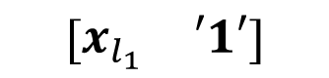
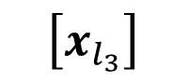
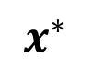
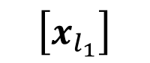
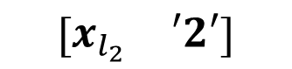

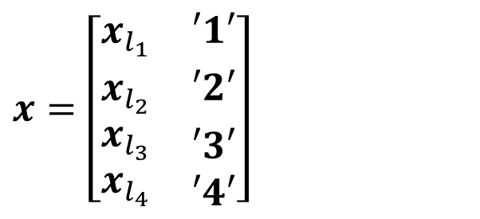
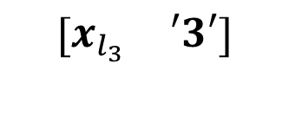


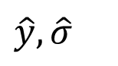
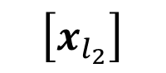
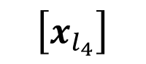
Multi-fidelity modeling with LMGP
1
Augment Inputs with Data Source Index (assuming 4 sources)
$$\left[x_{l_{1}}\right]$$
$$\left[\begin{matrix}x_{l_{1}} & ′1′\end{matrix}\right]$$
3
Fit LMGP to the ALL data
$$\left[x_{l_{2}}\right]$$
$$\left[\begin{matrix}x_{l_{2}} & ′2′\end{matrix}\right]$$
LMGP
$$x^{∗}$$
$$\hat{y}, \hat{σ}$$
$$\left[x_{l_{3}}\right]$$
$$\left[\begin{matrix}x_{l_{3}} & ′3′\end{matrix}\right]$$
$$\left[x_{l_{3}}\right]$$
$$\left[x_{l_{4}}\right]$$
$$\left[\begin{matrix}x_{l_{4}} & ′4′\end{matrix}\right]$$
Fuse any number of data sources
No assumptions on discrepancies of data sources
No assumption on the hierarchy of data sources
2
Concatenate Datasets
$x=\left[\begin{matrix}x_{l_{1}} & ′1′ \\ x_{l_{2}} & ′2′ \\ \begin{aligned}x_{l_{3}} \\ x_{l_{4}}\end{aligned} & \begin{aligned}′3′ \\ ′4′\end{aligned}\end{matrix}\right]$
$y=\left[\begin{matrix}y_{l_{1}} \\ y_{l_{2}} \\ \begin{aligned}y_{l_{3}} \\ y_{l_{4}}\end{aligned}\end{matrix}\right]$
Eweis-Labolle, J. T., Oune, N. & Bostanabad, R. Data Fusion With Latent Map Gaussian Processes. Journal of Mechanical Design 144, 1-41.

Slide 12

Challenges
Multiple coexisting uncertainty sources:
(1) Lack of high-fidelity data (2) Stochastic nature of the data sources
(3) Mixed feature space: Non-differentiable qualitative inputs
(4) Bias of low-fidelity data: Convergence to incorrect optima
Zanjani Foumani, Z., et al., Multi-fidelity cost-aware Bayesian optimization. Computer Methods in Applied Mechanics and Engineering, 2023. 407: p. 115937.

Slide 13


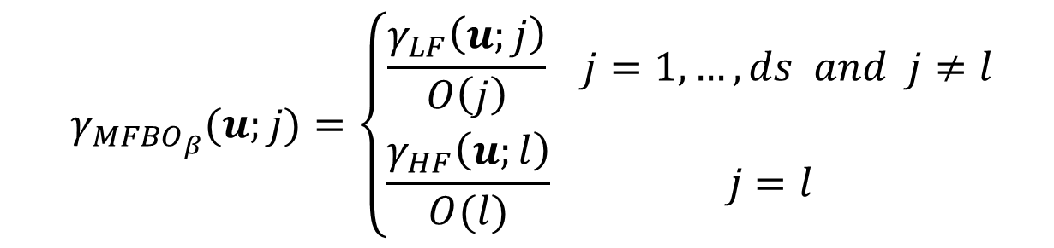
developed acquisition function (AF)
Our idea: Expected utility of low- and high-fidelity data should be measured differently!
Low-fidelity: Exploration
High-fidelity: Exploitation
Low-fidelity: Use the exploration part of expected improvement (EI)
High-fidelity: Use probability of improvement (PI)
Final acquisition function (AF):
$$γ_{LF}\left(u;j\right)= σ_{j}\left(u\right)φ\left(\frac{y_{j}^{∗}− μ_{j}\left(u\right)}{σ_{j}\left(u\right)}\right)$$
$$γ_{HF}\left(u;l\right)= ψ(\frac{ μ_{l}(u){− y}_{l}^{∗}}{σ_{l}(u)})$$
$$γ_{{MFBO}_{β}}(u;j)=\left\{\begin{aligned}\frac{γ_{LF}\left(u;j\right)}{O\left(j\right)} j=1,…,ds & &and j≠l& \\ \frac{γ_{HF}\left(u;l\right)}{O(l)} j=l\end{aligned}\right.$$
Zanjani Foumani, Z., et al., Multi-fidelity cost-aware Bayesian optimization. Computer Methods in Applied Mechanics and Engineering, 2023. 407: p. 115937.

Slide 14
developed acquisition function (AF)
Our AF samples LF sources where they are more correlated with the HF and are more informative.
Zanjani Foumani, Z., et al., Multi-fidelity cost-aware Bayesian optimization. Computer Methods in Applied Mechanics and Engineering, 2023. 407: p. 115937.

Slide 15
Optimum data collection
Design of $M_{2}AX$ nanolaminate ternary alloys that exhibit many of the beneficial properties of both ceramic and metallic materials:
$$\left.\begin{matrix}\text{An} \text{early} \text{transition} \text{metal} M=\left\{Sc, Ti, V, Cr, Zr, Nb, Mo, Hf, Ta, W\right\} → 10 \\ \text{A} \text{main} \text{group} \text{element} A=\left\{Al, Si, P, S, Ga, Ge, As, Cd, In, Sn, Tl, Pb\right\} → 12 \\ \text{Either} \text{carbon} \text{or} \text{nitrogen} X=\left\{C, N\right\} → 2 \end{matrix}\right\}→$$
$$240$$
Q.1. How can we find the composition with the largest bulk modulus without running 240 expensive DFT simulations?
Q.2. Can we use inaccurate but cheap simulations?
Zhou, Y.C., H.Y. Dong, X.H. Wang, and S.Q. Chen, Electronic structure of the layered ternary carbides ti2snc and ti2gec. Journal of Physics: Condensed Matter, 2000. 12(46): p. 9617.

Slide 16
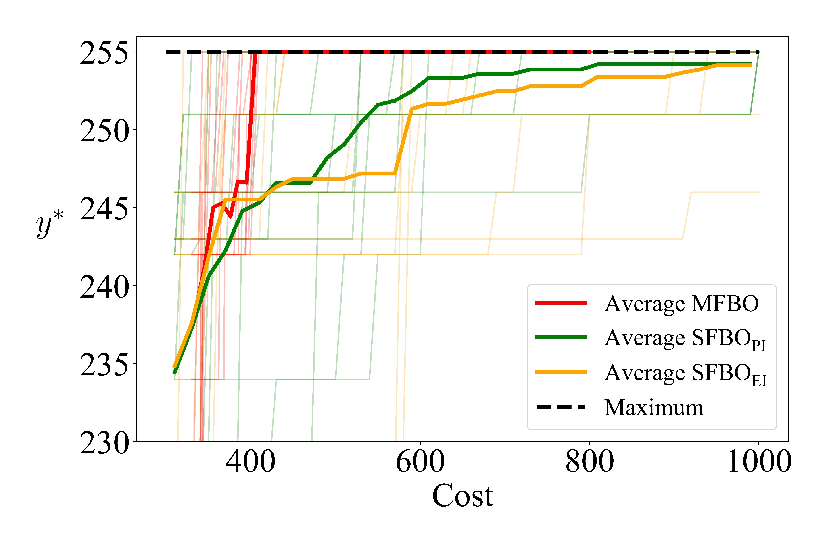
Results: composition design application
Dimension: 10 (3 categorical and 7 numerical features)
Cost ratio of HF/LF: 10/1
Initialization:10HF/20LF
15 repetitions
Convergence vs Cost
Multi-fidelity BO converges much faster
Zanjani Foumani, Z., et al., Multi-fidelity cost-aware Bayesian optimization. Computer Methods in Applied Mechanics and Engineering, 2023. 407: p. 115937

Slide 17
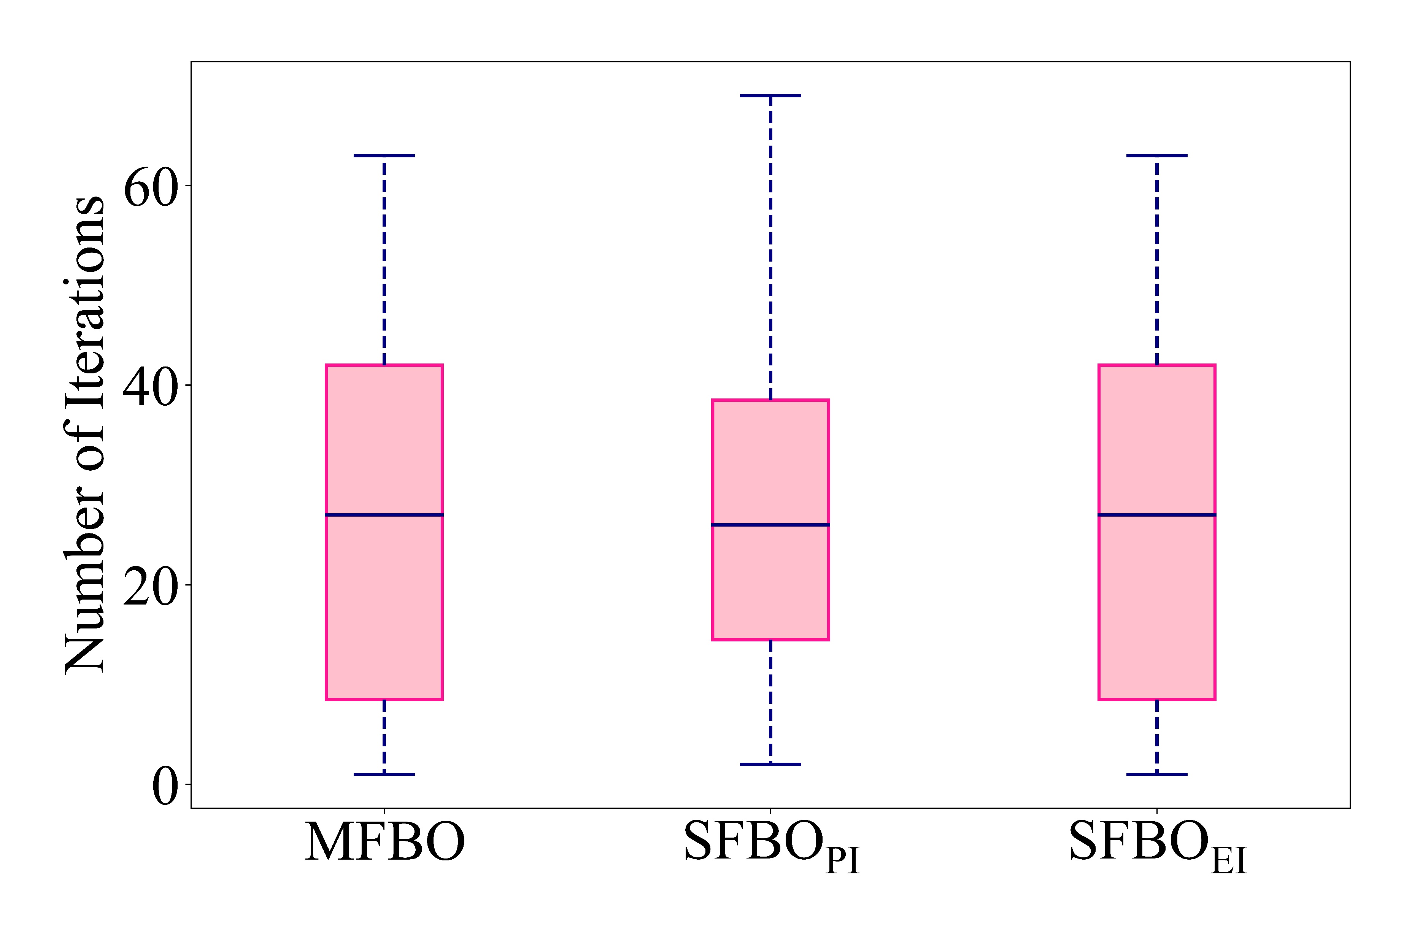
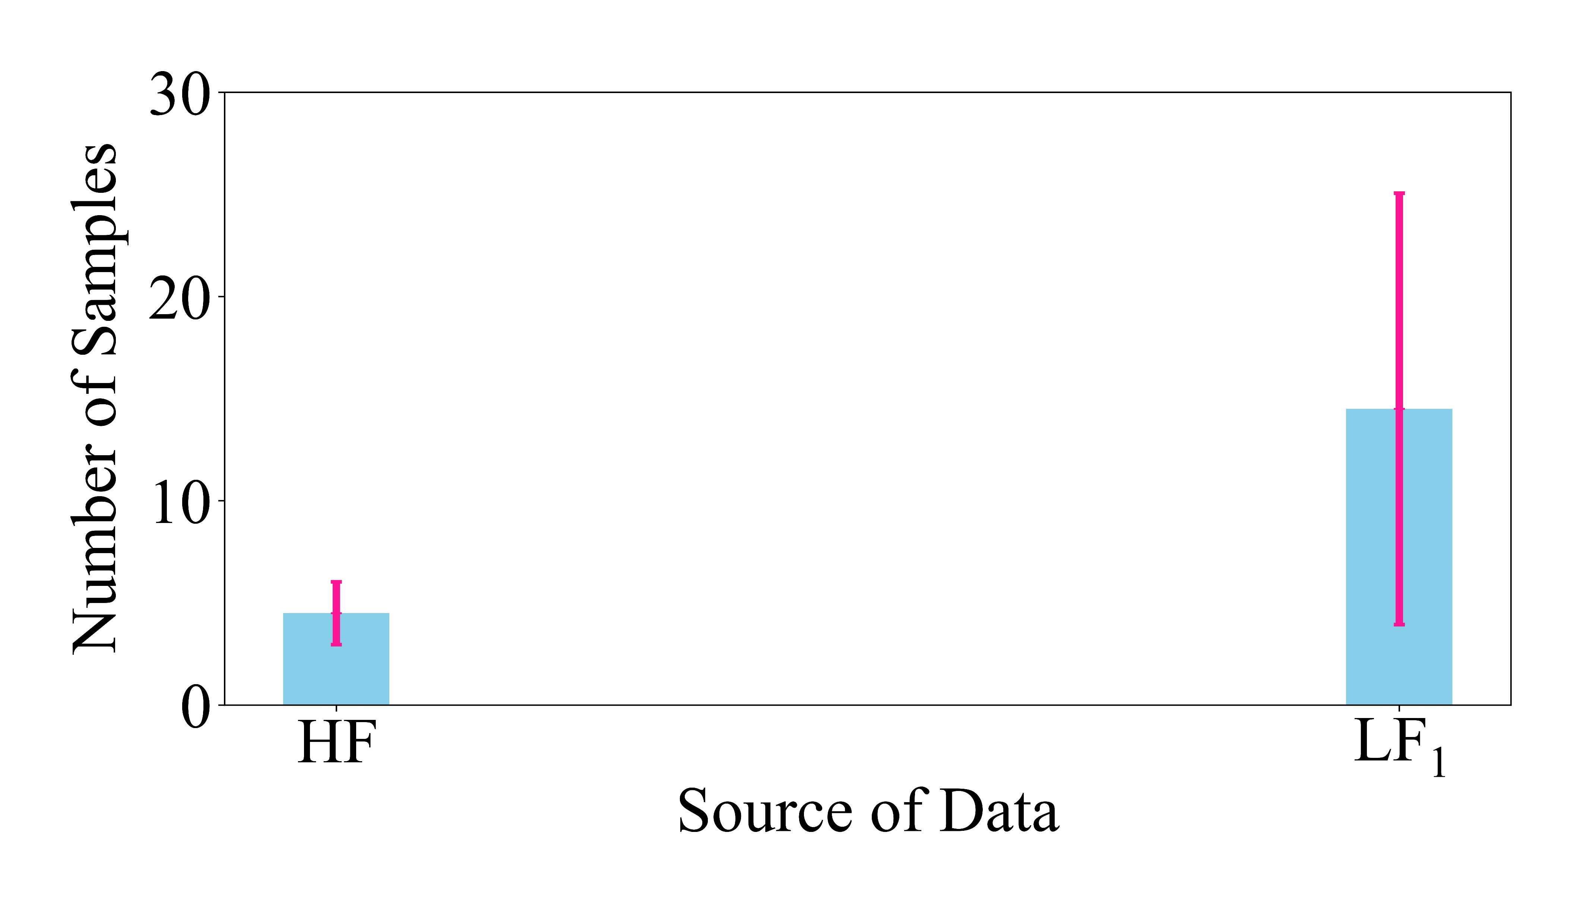
Results: composition design application
Total number of iterations are comparable across different methods.
Our multi-fidelity BO samples more from low-fidelity source.
Zanjani Foumani, Z., et al., Multi-fidelity cost-aware Bayesian optimization. Computer Methods in Applied Mechanics and Engineering, 2023. 407: p. 115937

Slide 18
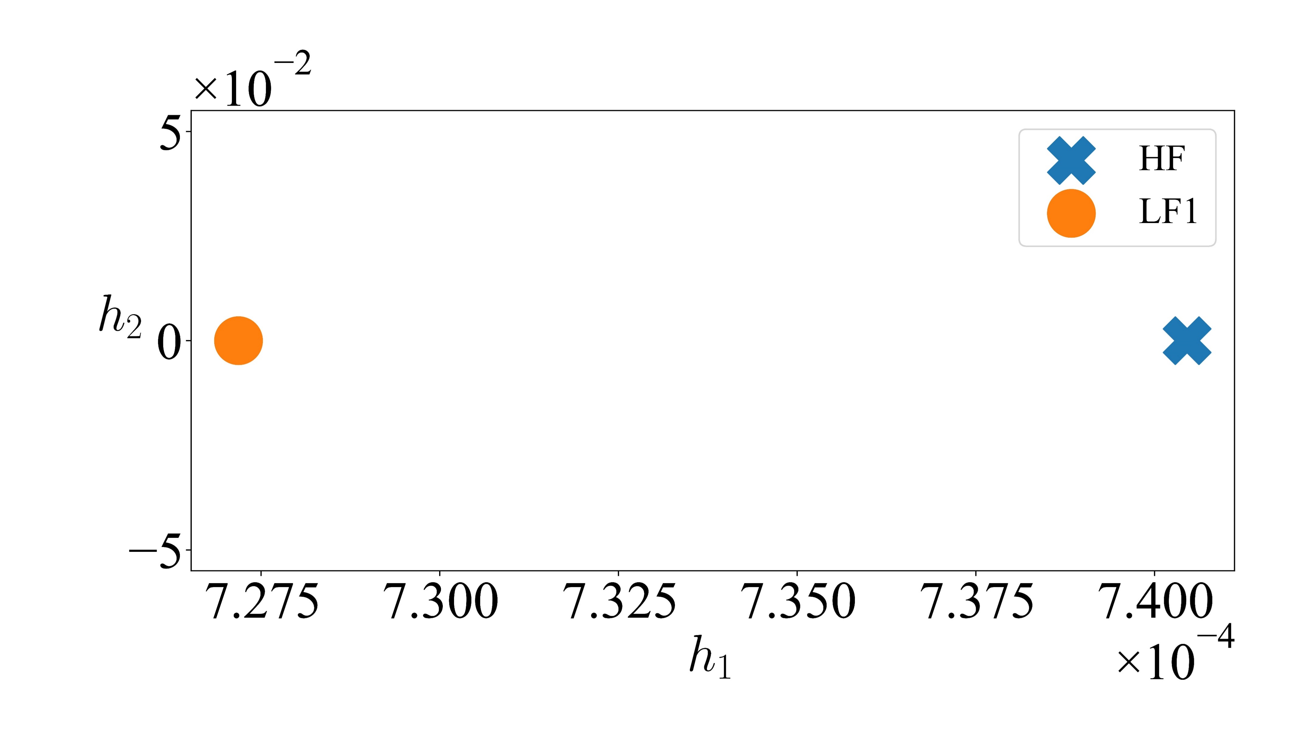
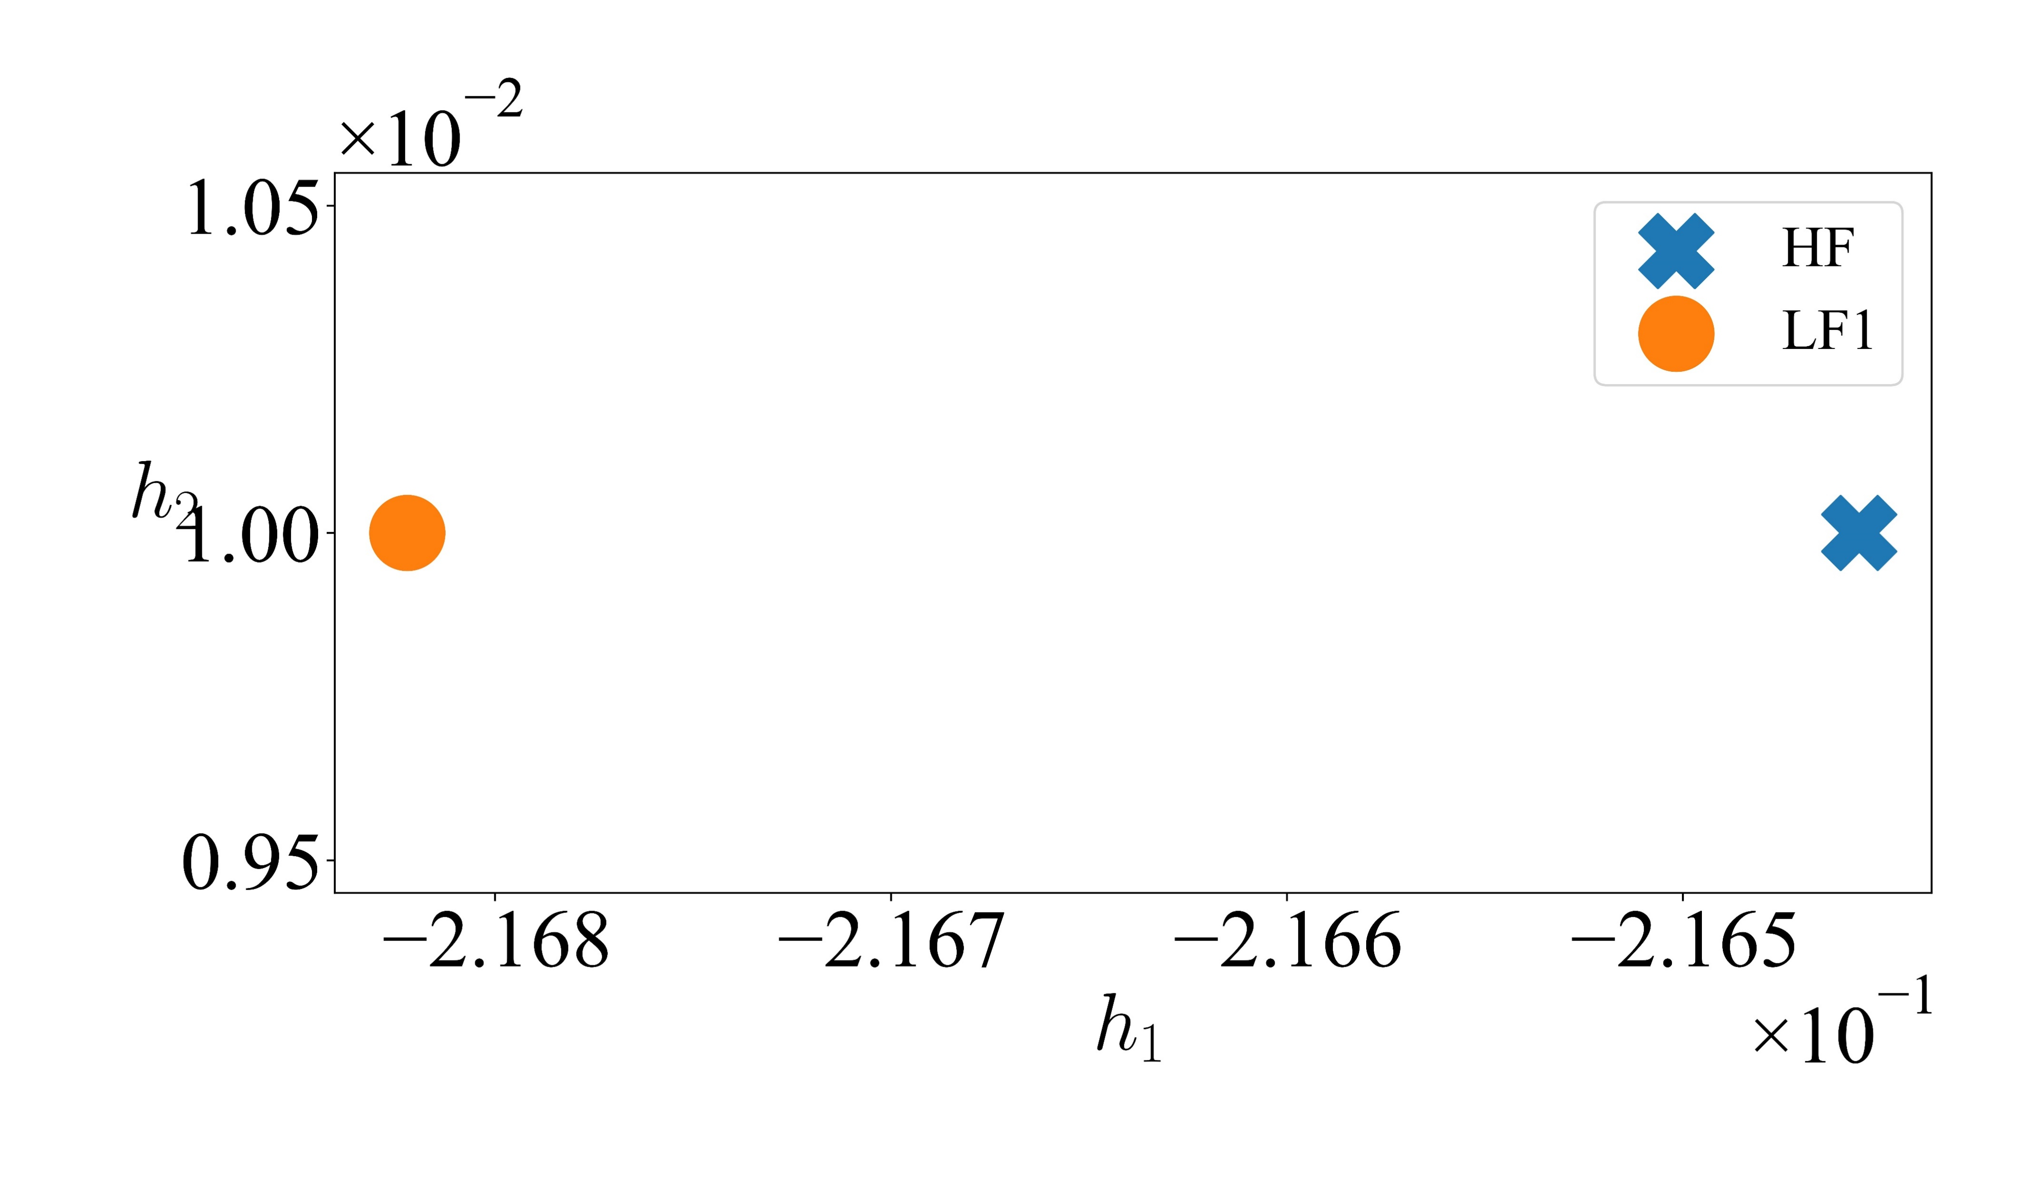
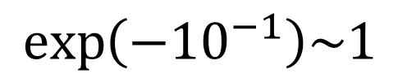
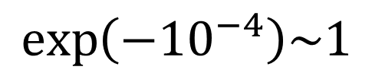
Learnt manifolds: Data source
The learnt manifold of M2AX
Using initial data
Using all the data
Cross-source correlation based on nonlinearly learnt latent variable:
$$\exp\left(−{10}^{−4}\right)\sim 1$$
$$\exp\left(−{10}^{−1}\right)\sim 1$$
Zanjani Foumani, Z., et al., Multi-fidelity cost-aware Bayesian optimization. Computer Methods in Applied Mechanics and Engineering, 2023. 407: p. 115937

Slide 19
Will Multi-fidelity BO always outperform Single-fidelity BO?
Zanjani Foumani, Z., et al., Multi-fidelity cost-aware Bayesian optimization. Computer Methods in Applied Mechanics and Engineering, 2023. 407: p. 115937.

Slide 20
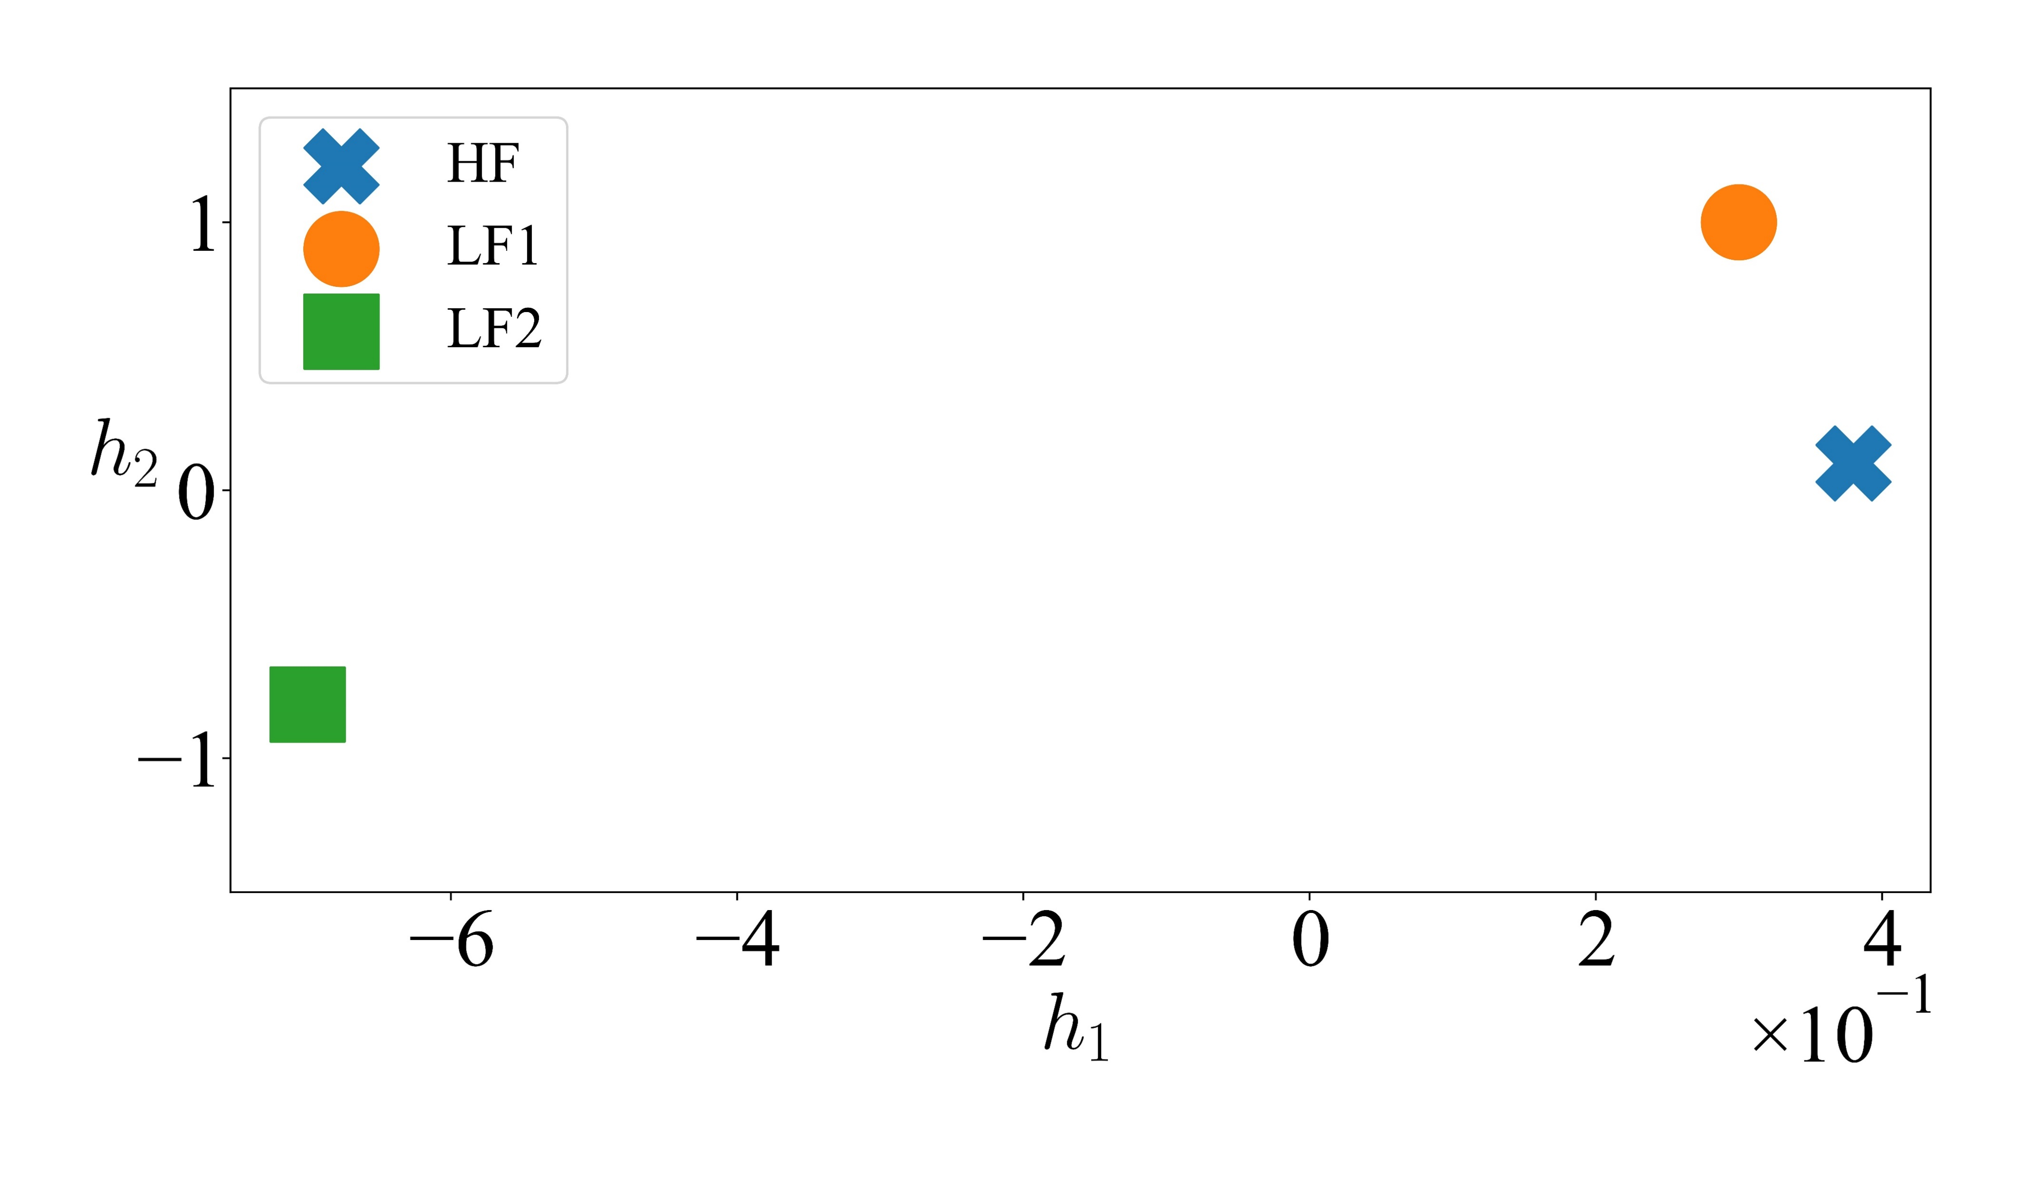



Hybrid Organic-Inorganic Perovskite (HOIP)
HOIPs are crystals with the structural formula $ABX_{3}$:
$A→10$ levels
$B→3$ levels
$X→16$ levels
Fidelity manifold via initial data
$3$ data sources
Initial data: $15−20−15$
Cost: $15−10−5$
Repetitions: 20
Low-fidelity sources will NOT help!
Zanjani Foumani, Z., et al., Multi-fidelity cost-aware Bayesian optimization. Computer Methods in Applied Mechanics and Engineering, 2023. 407: p. 115937

Slide 21

BO convergence
As expected, single-fidelity outperforms multi-fidelity BO!
Zanjani Foumani, Z., et al., Multi-fidelity cost-aware Bayesian optimization. Computer Methods in Applied Mechanics and Engineering, 2023. 407: p. 115937

Slide 22




Comparison studies on analytic functions
Our method outperforms BoTorch which is look-ahead.
1D
2D
8D
10D
Zanjani Foumani, Z., et al., Multi-fidelity cost-aware Bayesian optimization. Computer Methods in Applied Mechanics and Engineering, 2023. 407: p. 115937.

Slide 23
Concluding remarks
Our Multi-Fidelity Cost-Aware Bayesian Optimization:
Reduces the need to do lots of expensive simulations
Handles lack of high-fidelity data
Emulates multiple data sources with unknown fidelities
Provides a metric for the correlation of the data sources
Handles categorical data
Manages biased data sources
The open-source code will be available by the end of this summer.

Slide 24


acknowledgment
Collaborators:
Mehdi Shishehbor
Postdoc
Amin Yousefpour
PhD Student
Tammer Eweis-Labolle
PhD Student
Funding:
The UC National Laboratory Fees Research Program of the University of California
Early Career Faculty grant from NASA’s Space Technology Research Grants Program
Thank you! Questions?

Slide 25
Appendix

Slide 26

Learnt manifolds: categorical variables
M2AX has 3 categorical variables with 10,12, 2 distinct levels.
LMGP maps these categorical variables to a lower-dimensional space.
First Categorical Variable
Second Categorical Variable
Third Categorical Variable

Slide 27

Learnt manifolds: categorical variables
HOIP has 3 categorical variables with 10,3,16 distinct levels.
First Categorical Variable
Second Categorical Variable
Third Categorical Variable

Slide 28


BO CONVERGENCE IN HOIP
Lower cost (fewer iterations) is not always good!
Convergence to a suboptimal compound stops BO earlier.
Zanjani Foumani, Z., et al., Multi-fidelity cost-aware Bayesian optimization. Computer Methods in Applied Mechanics and Engineering, 2023. 407: p. 115937

